Slide 1






⥫
Cracking the Code: Predicting Online Course Completion with Machine Learning

Slide 2






Cracking the Code: Predicting Online Course Completion
Explore how machine learning can help understand the factors that influence online course completion. Discover key insights to improve student success and retention

Slide 3






The Challenge of Online Course Completion
Online courses offer flexibility, but face high dropout rates. Understanding the factors that lead to successful completion is crucial for improving student outcomes.

Slide 4

Leveraging Machine Learning for Insights
Machine learning models can identify patterns and predict which students are more likely to complete online courses. These insights can inform interventions and support strategies.

Slide 5







TOOLS AND FRAMEWORKS
Python 3.0 JupyterNotebook Kaggle
Anaconda Navigator

Slide 6





LIBRARIES IN PYTHON
Numpy Pandas Seaborn
Plotly sklearn
cufflinks

Slide 7
Identifying Key Predictors of Completion
Factors such as:-
CourseCategory: Category of the course taken by the user (e.g., Programming, Business, Arts)
TimeSpentOnCourse: Total time spent by the user on the course in hours
NumberOfVideosWatched: Total number of videos watched by the user
NumberOfQuizzesTaken: Total number of quizzes taken by the user
QuizScores: Average scores achieved by the user in quizzes (percentage)
CompletionRate: Percentage of course content completed by the user
DeviceType: Type of device used by the user (Device Type: Desktop (0) or Mobile (1)),
This can all influence online course completion. Machine learning can uncover these relationships.

Slide 8




Personalized Support for Student Success
By predicting which students are at risk of dropping out, instructors can provide tailored support and interventions to improve their chances of successful completion.

Slide 9
⥫
DATASET
AND
EDA

Slide 10

DATA SOURCE
The data is collected from Kaggle website. [https://www.kaggle.com/datasets/rab ieelkharoua/predict-online-course- engagement-dataset/data]

Slide 11





EXPLORATORY DATA AaNALYSIS
FEATURES OF DATASET
CourseCategory
TimeSpentOnCours
NumberOfVideosWatched
NumberOfQuizzesTaken
QuizScores
CompletionRate
DeviceType
CourseCompletion

Slide 12
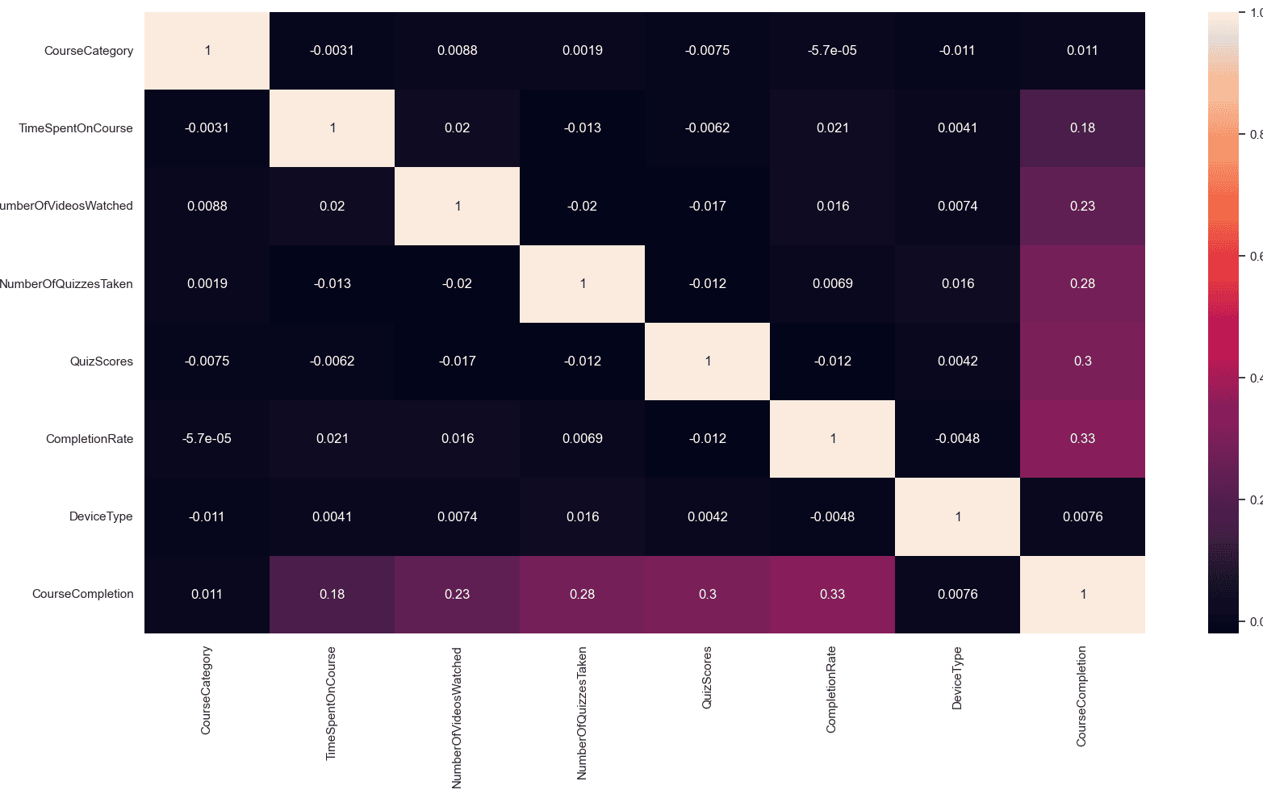
HEATMAP FOR CORRELATION OF FEATURES

Slide 13
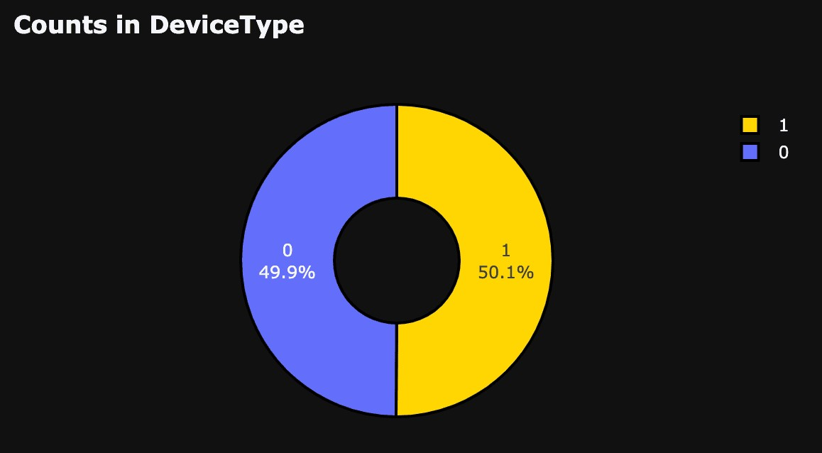
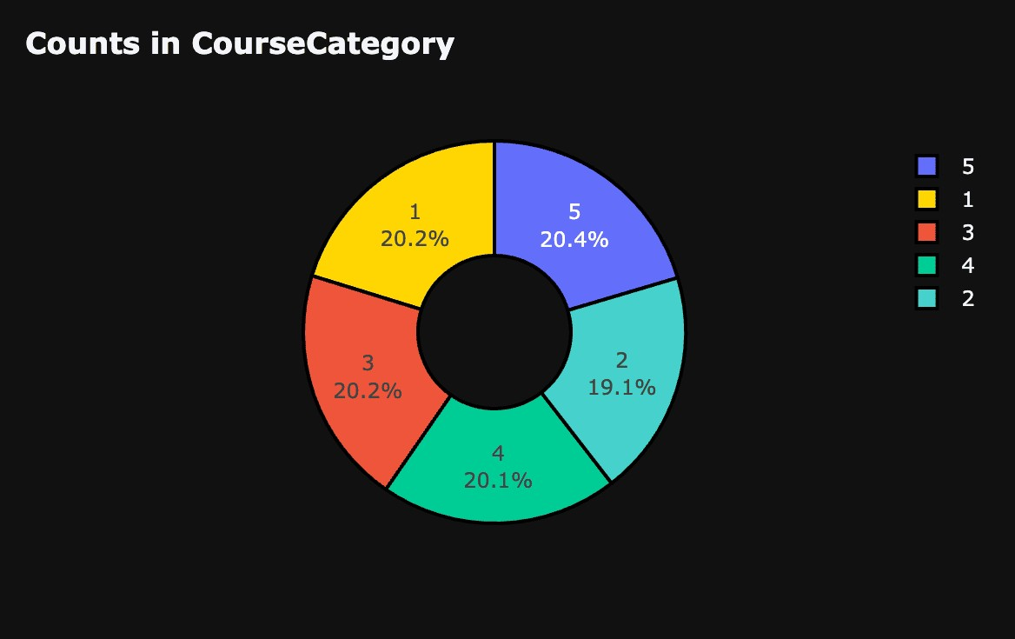
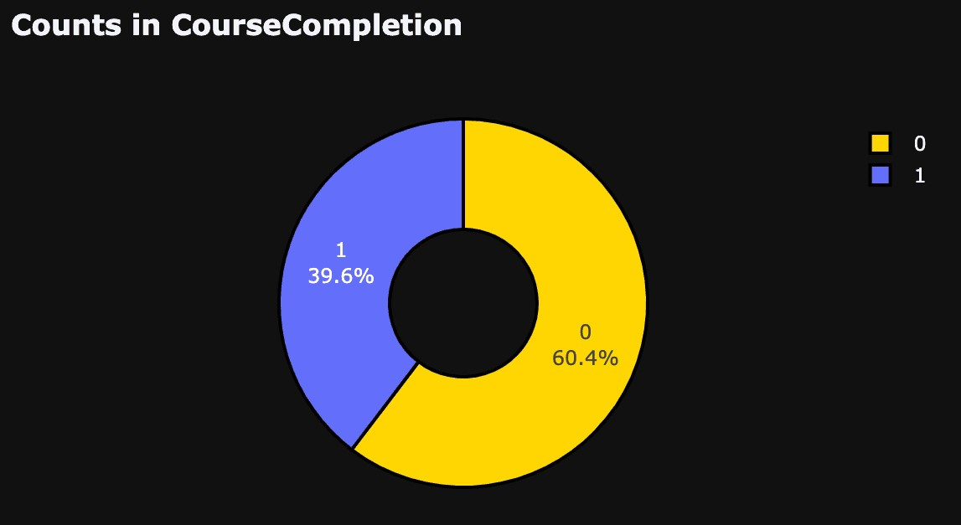
DATA DISTRIBUTION IN FEATURES

Slide 14


ML MODELS
Logistic Regression, DecisionTree, GradiantBoost, RandomForest, KNeighborsClassiﬁer

Slide 15
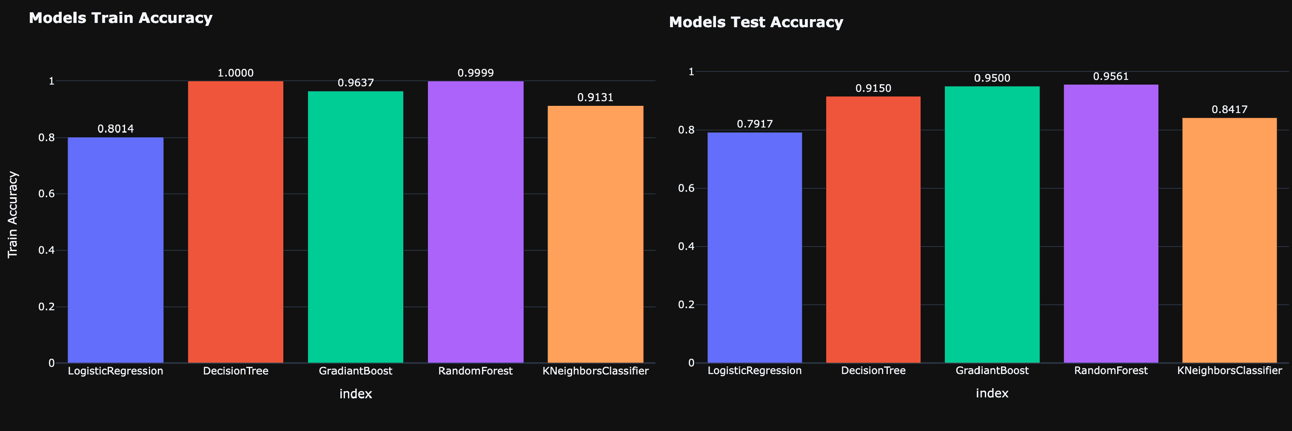
PERFORMANCE OF MODELS

Slide 16
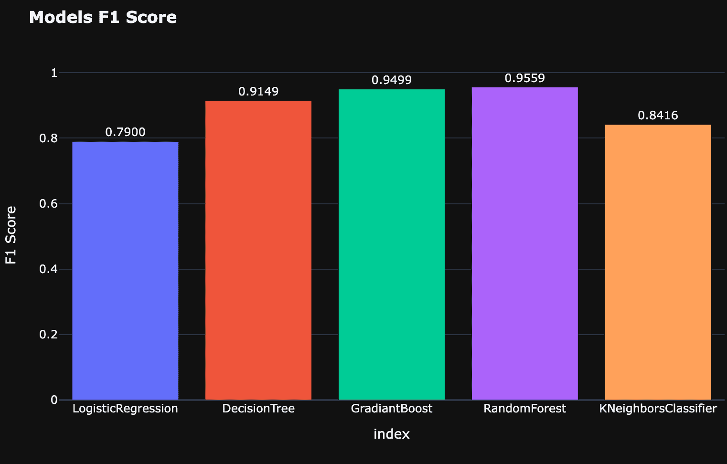
PERFORMANCE OF MODELS

Slide 17
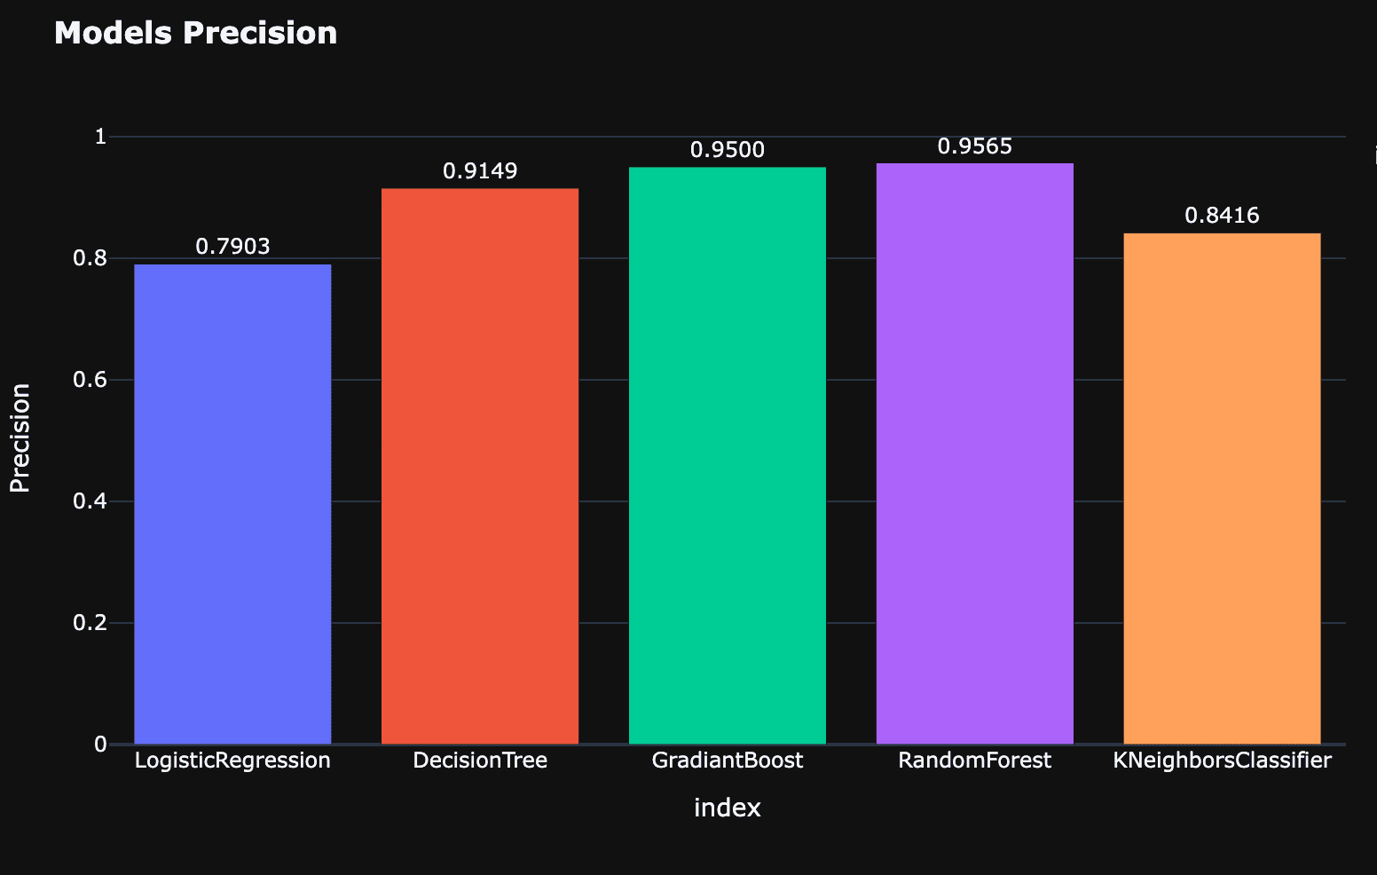
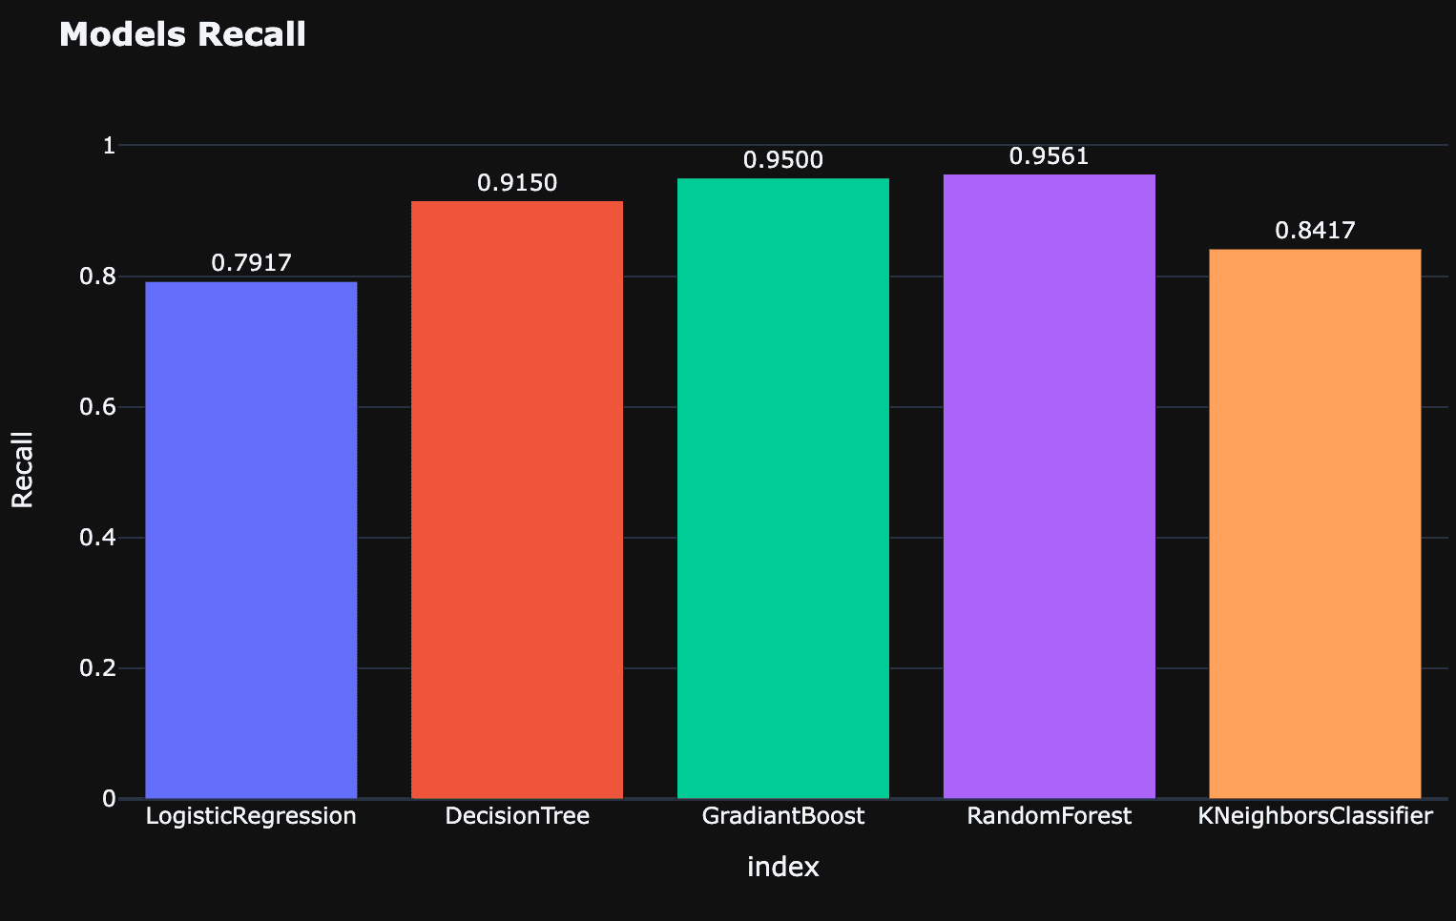
PERFORMANCE OF MODELS

Slide 18



Conclusion: Random Forest performed the best.
By implementing the Random Forest, we can crack the code of online course completion and unlock the full potential of flexible, accessible education for all learners. So that the course completion rates can be increased.

Slide 19









Thanks!
Parth Maheshwari
maheshwariparth7890@gmail.com
+91 9824536053
https://www.linkedin.com/in/pa rth-maheshwari-2813ba299

